Slide 1
Anomaly Detection in Human Vitals Using Machine Learning
Student Name: Eswar Surya Danaboina
Student ID: 20061702
Supervisor: Muhammad Asad
Institution: Dublin Business School
Year: 2025

Slide 2
Introduction & Problem Statement
Continuous monitoring of human vital signs is critical in modern healthcare
Manual monitoring is time-consuming and prone to human error
Abnormal physiological patterns may indicate early health risks
There is a need for an automated, scalable, and interpretable anomaly detection system
Problem:
Identifying abnormal vital sign patterns without labelled medical data is challenging.

Slide 3
Research Aim & Objectives
Research Aim
To develop an explainable machine learning framework for detecting anomalies in human vital signs.
Objectives
Analyse multivariate human vital signs data
Apply an unsupervised anomaly detection model
Detect abnormal health patterns automatically
Provide explainability for model decisions using SHAP
Visualise and interpret anomaly results

Slide 4
Dataset Overview
The dataset contains physiological and demographic features, including:
Heart Rate
Respiratory Rate
Body Temperature
Oxygen Saturation
Systolic and Diastolic Blood Pressure
Age, Gender, Height, Weight
Derived features:
  BMI
  Heart Rate Variability (HRV)
  Mean Arterial Pressure (MAP)
  Pulse Pressure
The dataset is large-scale and suitable for unsupervised learning.

Slide 5
Methodology Overview
The overall workflow followed in this project:
Data loading and cleaning
Feature selection and normalisation
Anomaly detection using Isolation Forest
Identification of anomalous observations
Explainability using SHAP
Visual analysis of results
This pipeline ensures both performance and interpretability.

Slide 6
Why Isolation Forest?
Isolation Forest was selected because:
It is an unsupervised learning algorithm
No labelled anomaly data is required
Efficient for large datasets
Detects anomalies by isolating rare observations
Widely used in healthcare and anomaly detection research
This makes it suitable for real-world medical data scenarios.

Slide 7
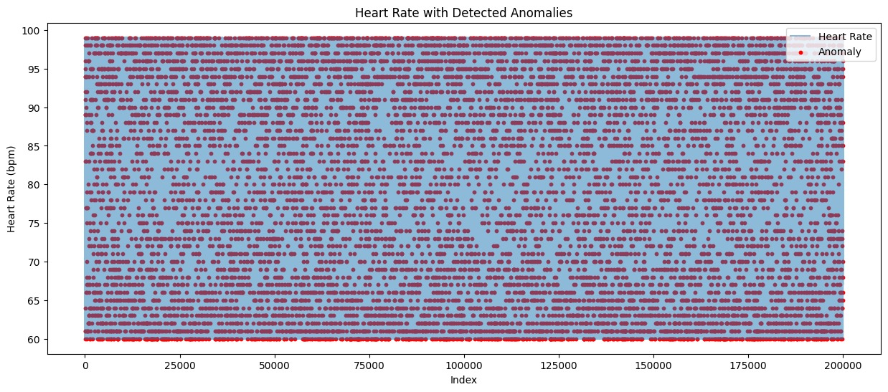
Anomaly Detection Results
The model classifies observations as normal or anomalous
Red points represent detected anomalies
Abnormal heart rate values are clearly isolated
Demonstrates effective separation between normal and abnormal patterns

Slide 8
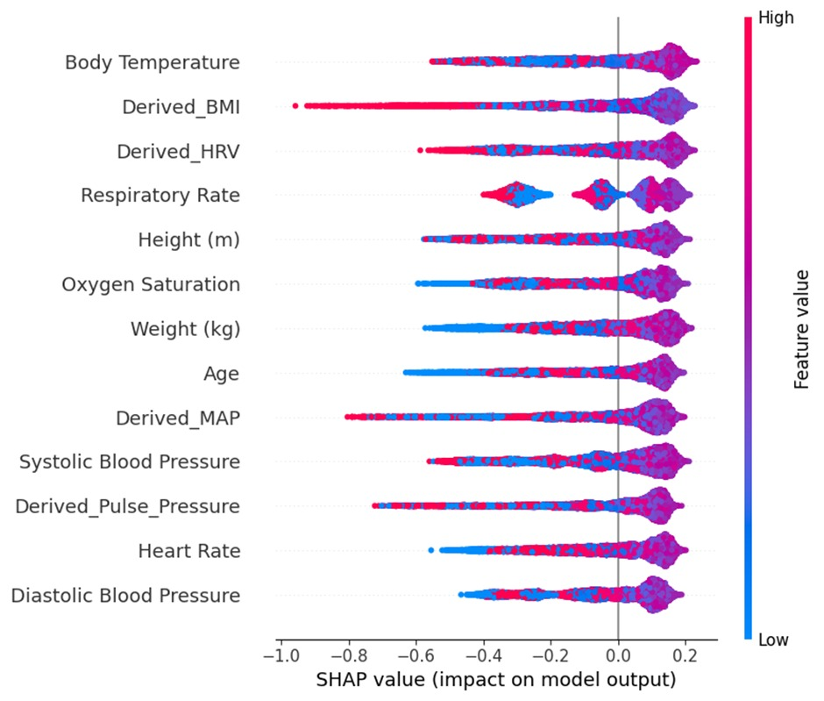
Model Explainability Using SHAP
SHAP explains the contribution of each feature to anomaly detection
High-impact features include:
  Body Temperature
  Derived BMI
  HRV
  Respiratory Rate
This improves trust and transparency in medical decision-making.

Slide 9
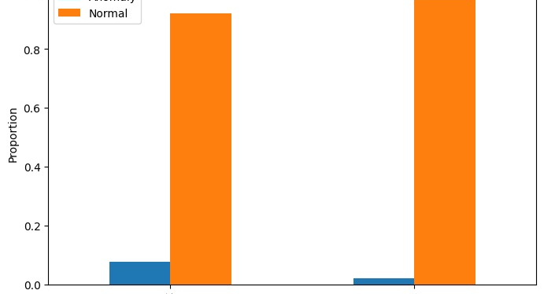
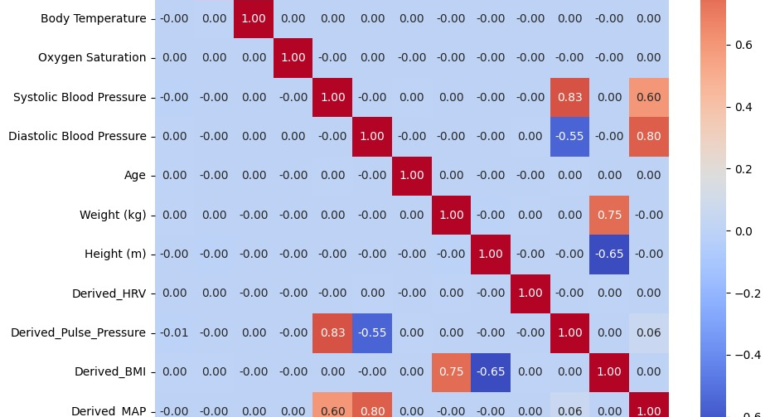
Additional Analysis
Risk-based anomaly distribution analysis
Gender-wise and temporal anomaly trends
Correlation analysis between vital signs
These analyses support deeper clinical interpretation.

Slide 10
Key Findings
Isolation Forest successfully detects anomalous vital sign patterns
SHAP provides clear explanations for model outputs
Derived physiological features significantly influence anomaly detection
The framework balances accuracy and interpretability

Slide 11
Limitations & Future Work
Limitations
No ground truth labels available
Dataset is synthetic / simulated
Not evaluated in real-time clinical settings
Future Work
Use real hospital or wearable device data
Combine with deep learning models
Implement real-time alert systems
Clinical validation with healthcare professionals

Slide 12
Conclusion
An explainable anomaly detection framework was successfully developed
The approach effectively identifies abnormal health patterns
Model transparency makes it suitable for healthcare applications
The system has strong potential for early warning health monitoring

Slide 13
Thank you
Eswar Surya Danaboina
eswarsurya89@gmail.com

